Slide 1
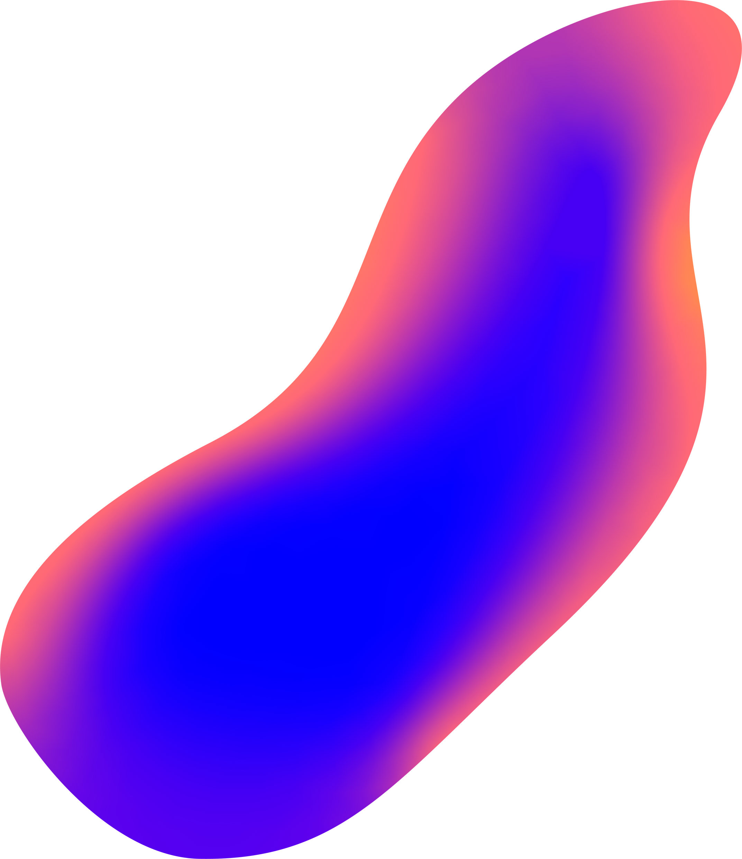

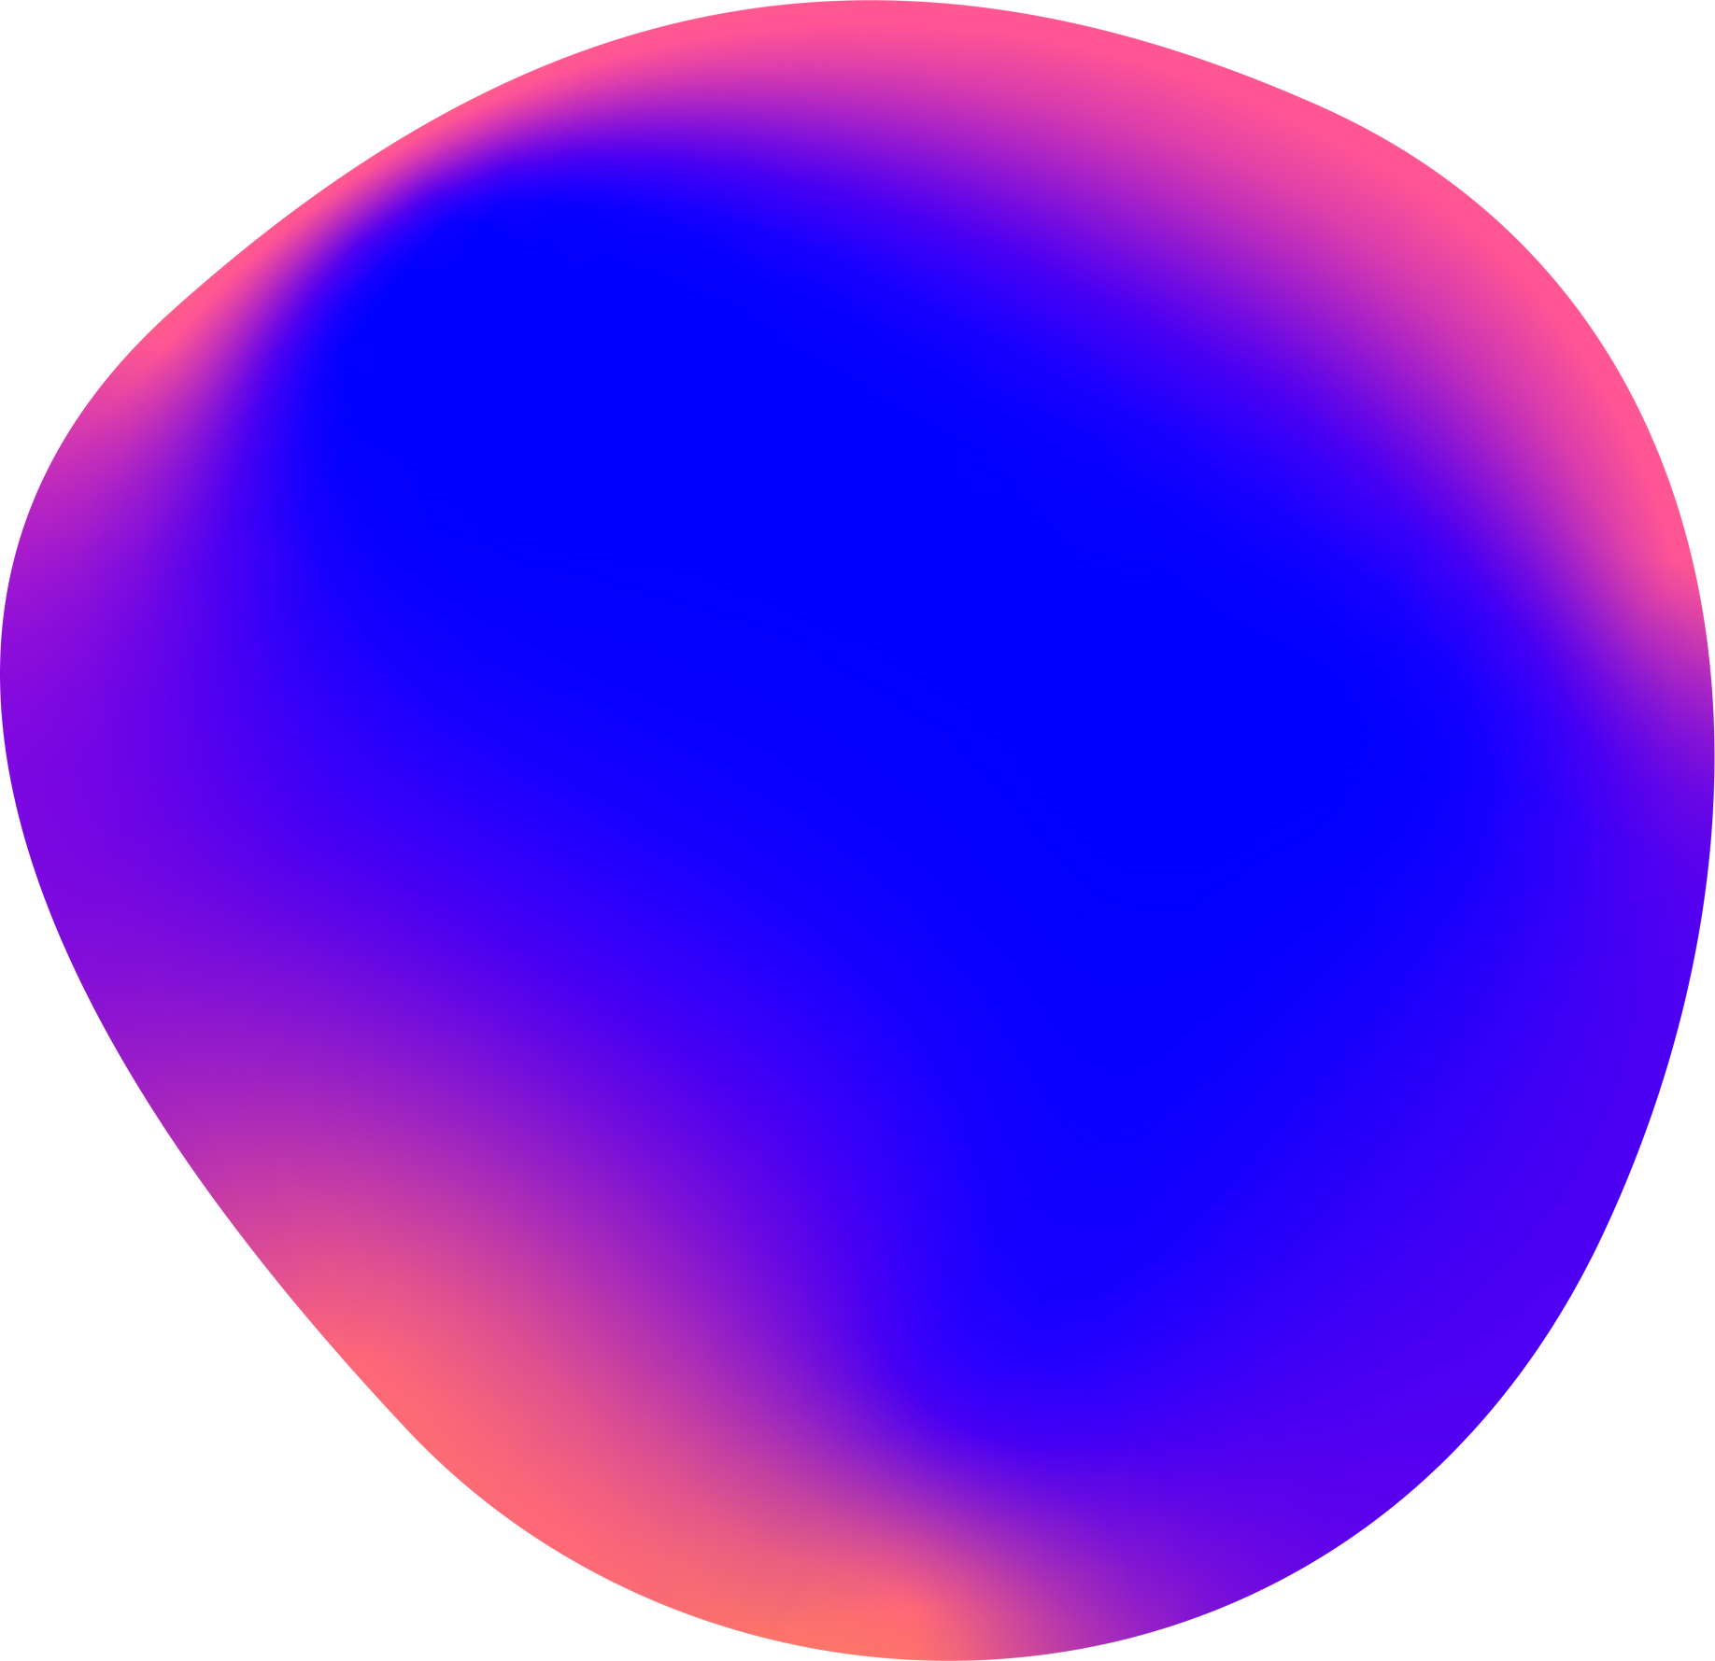

HAND GESTURE RECOGNITION USING OVERHEAD CAMERAS TO BUILD Virtual Cart
PRESENTATION BY
VISIONARIES

Slide 2
JUST WALK OUT

Slide 3


MEET
OUR TEAM
SRI KAVI SELVAN
AJURAM
3RD Year Computer Engineering Students from Karunya Institute of Technologies and Sciences

Slide 4


PROBLEM
STATEMENT
Our Problem statement address the need for a precise and user-friendly hand gesture recognition system that can accurately identify and interpret specific gestures performed by customers as they interact with products on store shelves. This system must be seamlessly integrated with the customer's digital shopping cart to offer a hassle-free and effortless way for them to manage their selected items

Slide 5

INTRODUCTION
We are developing a system that uses overhead cameras in retail stores to recognize hand gestures when customers pick up or return products. The ultimate goal is to create a virtual shopping cart, making the shopping experience more effortless and digital. This system allows customers to add and manage their selected items digitally, simplifying the shopping process.

Slide 6


ADVANTAGES
Time Savings: The elimination of checkout lines saves customers valuable time. This is especially appealing to people who want to grab a quick meal or snack during a busy workday.
Inventory Management: The technology used in this stores enables real-time inventory tracking. This can help ensure that the store is always well-stocked and that items are fresh.
Cashless Transactions: Just walk out stores are cashless, which can streamline the payment process and reduce the need for physical cash handling.

Slide 7


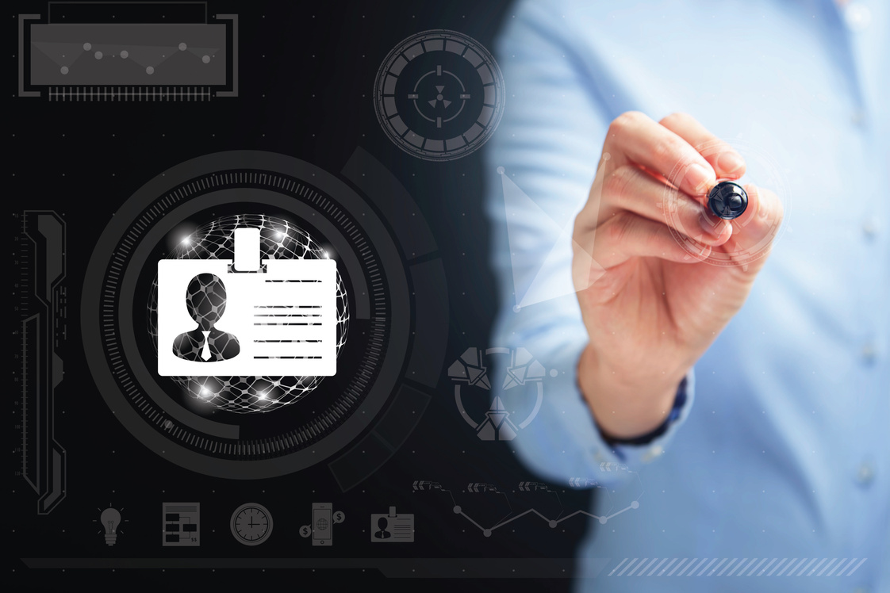
CHALLENGES
Privacy Concerns: Implementing facial recognition technology for person identification raises significant privacy concerns, potentially leading to public backlash and regulatory hurdles.
Consistent Lighting: Maintaining consistent and evenly distributed lighting in the store to mitigate the impact of natural lighting variations requires careful planning and design.
Person identification: Tracking which person buys which product is difficult with multiple people present.

Slide 8




MEDIAPIPE FOR HAND GESTURES DETECTION
METHODOLOGIES
YOLOV8 FOR PERSON AND OBJECT DETECTION
OVERVIEW
OPENCV2 FOR REAL-TIME CAPTURING

Slide 9
YOLOv8 is an object detection model that processes entire images, outputting class probabilities and bounding boxes. Object tracking assigns unique IDs to detected objects in video analytics. Pose estimation identifies specific keypoints on objects within the image.
PERSON
TRACKING

Slide 10
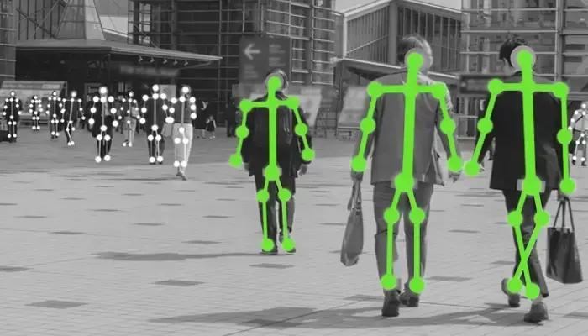
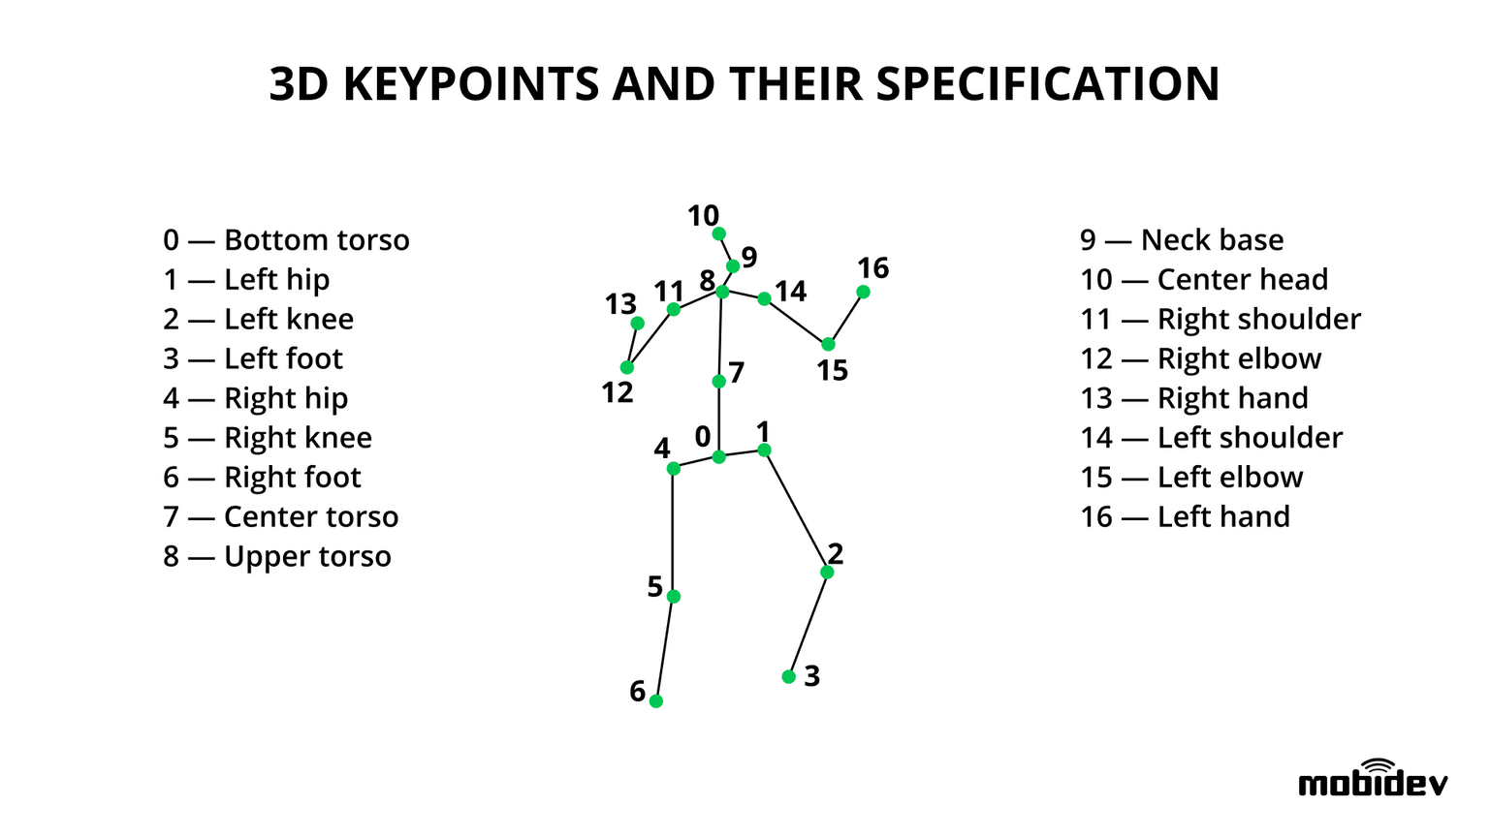
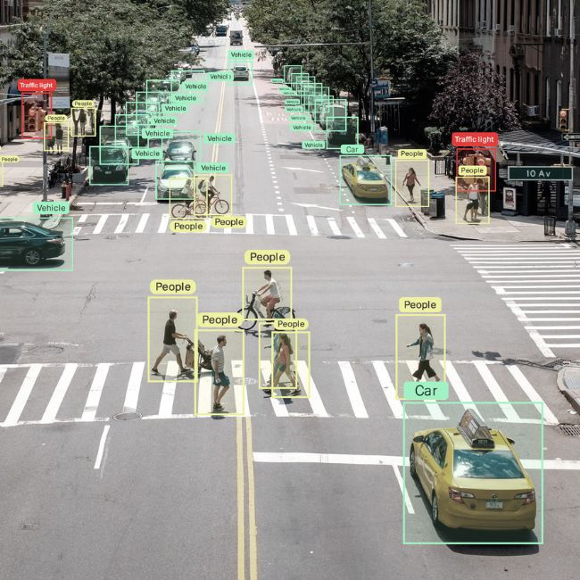
POSE RECOGNITION

Slide 11
YOLOv8 is an object detection model that processes entire images, outputting class probabilities and bounding boxes. Object tracking assigns unique IDs to detected objects in video analytics. Pose estimation identifies specific keypoints on objects within the image.
OBJECT POSITION
DETECTION

Slide 12
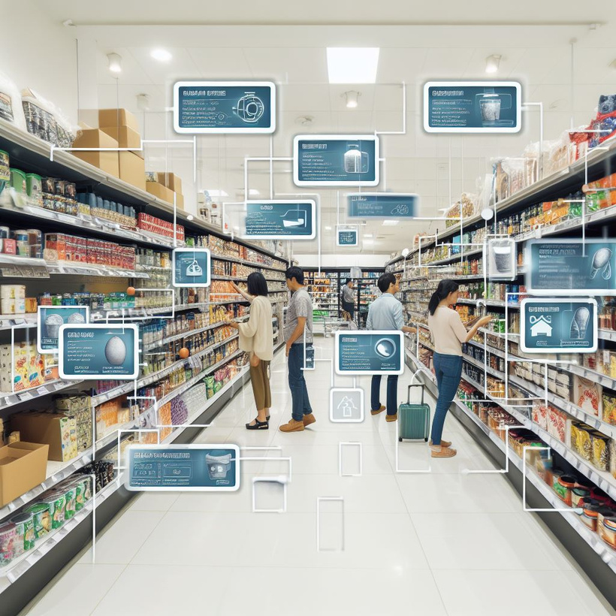
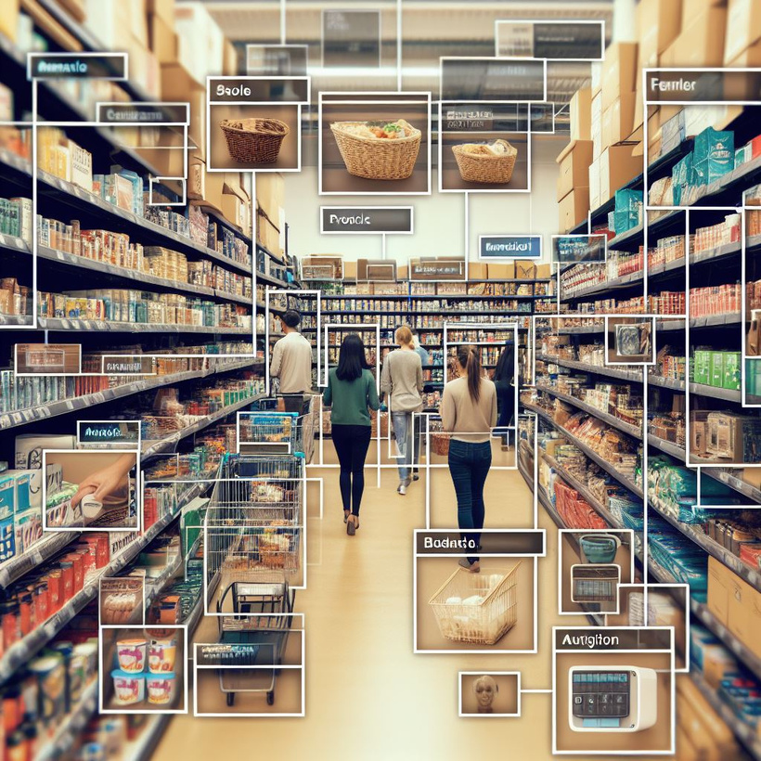

Slide 13
OPENCV2
INTEGRATION
OpenCV2, a versatile computer vision library, is at the core of our project's success. It enables real-time image processing, capturing and analyzing both customer interactions with products on store shelves and hand gestures. OpenCV2 plays a vital role in object detection, recognizing products, and facilitating efficient inventory tracking. Simultaneously, it ensures seamless interaction and accurate gesture recognition, enhancing the overall shopping experience with responsive and intuitive interactions.

Slide 14
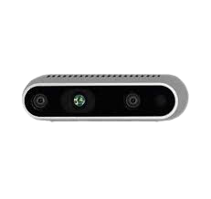
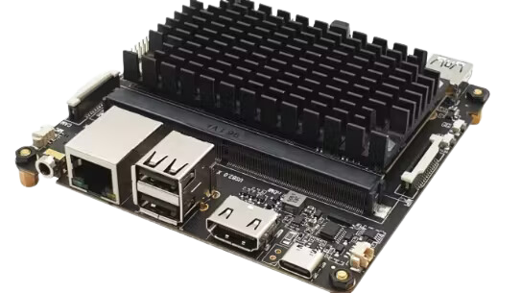
MINIMUM HARDWARE REQUIREMENTS
INTEL REALSENSE D435
ROCK PI N10

Slide 15
COST APPROXIMITY
For a 2000 sq feet, 2-floor retail store, using ROCK Pi N10 boards and Intel RealSense cameras, the hardware cost could be around ₹7,73,980. Software development might cost between ₹5,00,000 to ₹15,00,000. System integration could range from ₹2,00,000 to ₹6,00,000. Including an annual maintenance contract (10-20% of the total project cost), the total budget might range from ₹15,00,000 to ₹30,00,000. Please note these are rough estimates and actual costs could vary.

Slide 16

A PLATFORM
FOR VIRTUAL CART
We have designed a simple virtual cart for managing your inventory. You can add products to the cart, and they will be deducted from your stock. If you decide to remove a product from the cart and put it back on the shelves, it will be returned to your stock. In addition, you can also use the virtual cart to pay for the products purchased.

Slide 17
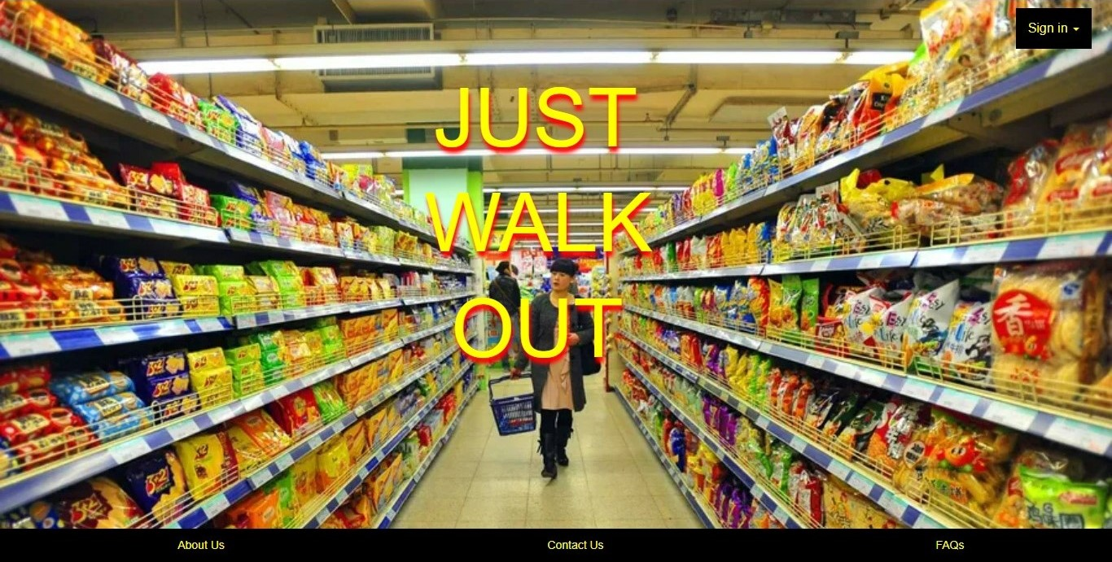

Slide 18
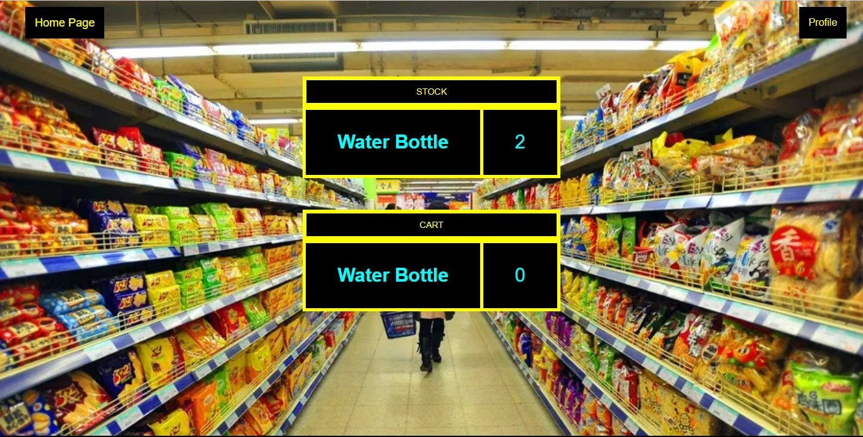

Slide 19
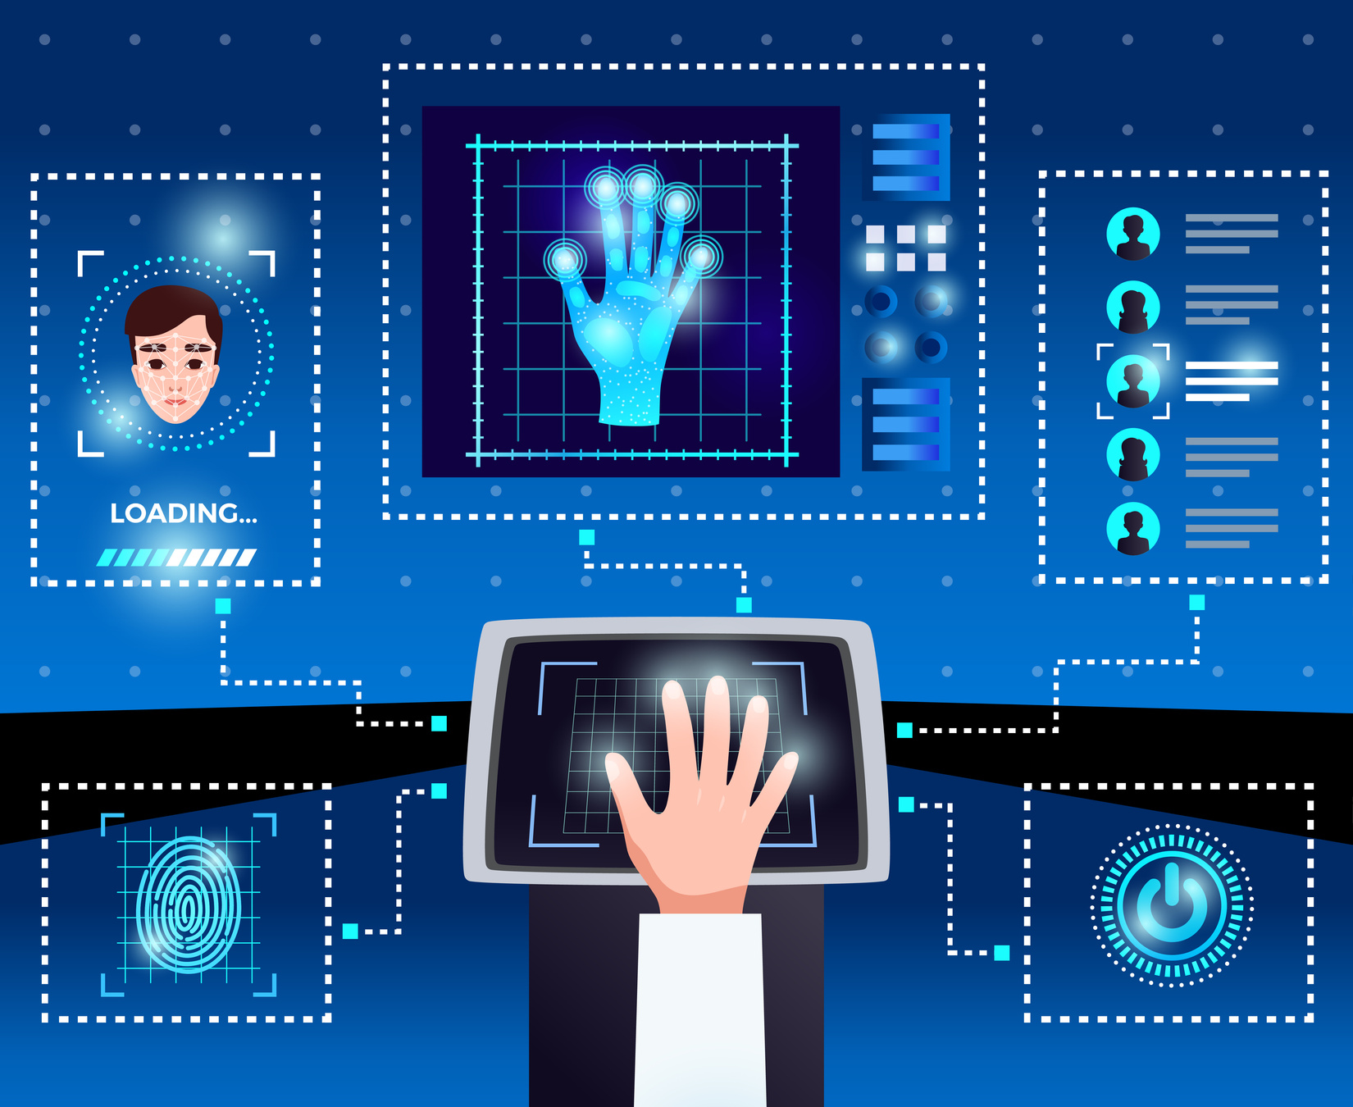

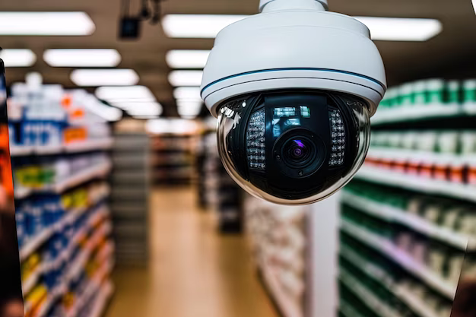
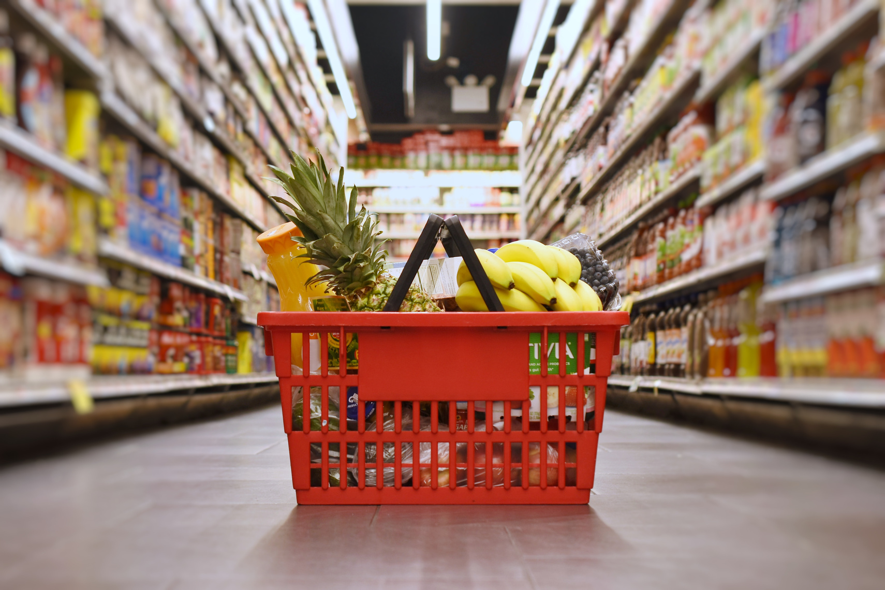

LET’S SEE THE MODEL WE BUILT
GITHUB LINK:
https://github.com/URK21CO3010/Hackathon-Final_Fight

Slide 20
HOW TO
AUTOMATE
Prepare Your Data:
Collect and preprocess your training data, ensuring it's labeled properly for object detection tasks.
Create Training Scripts:
Write Python scripts to train your YOLOv8 model. You can use deep learning frameworks like PyTorch or TensorFlow. Ensure your scripts include parameters for specifying model architecture, data paths, and training hyperparameters.
Version Control:
Use a version control system (e.g., Git) to manage your code, data, and model checkpoints. This helps you track changes, collaborate with a team, and maintain a history of your experiments.

Slide 21
HOW TO
AUTOMATE
Training Automation:
Automate the training process using scripts or job schedulers like cron (Linux), Task Scheduler (Windows), or cloud-based solutions (e.g., AWS Batch, Google Cloud AI Platform). These tools can run your training script at scheduled intervals or trigger training when new data is available.
Data Augmentation and Data Management:
Continuously update and expand your training dataset with new data to improve model performance. Implement data augmentation techniques to artificially increase your dataset's diversity.

Slide 22
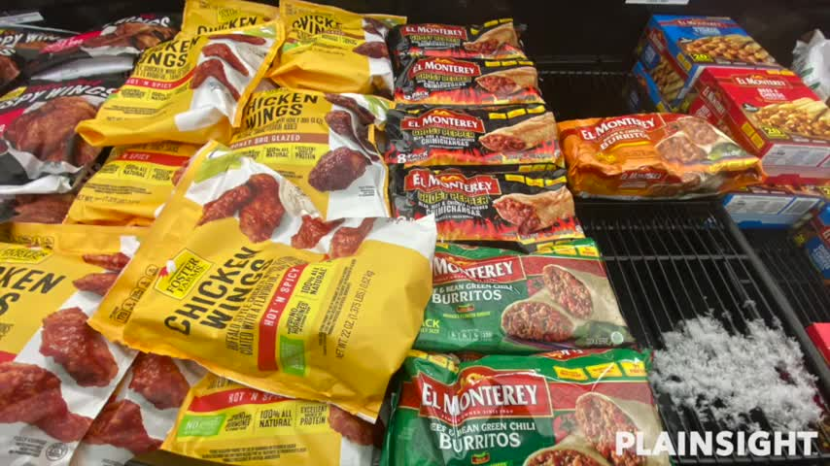
IMAGE SEGMENTATION

Slide 23
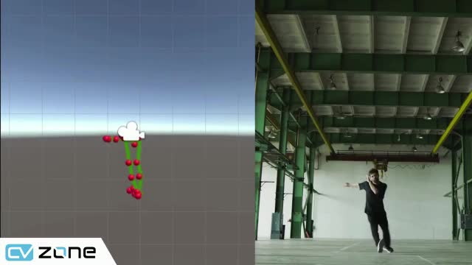

Slide 24
THANK
YOU!

